Slide 1
Introductory General Chemistry
Chemistry 3A
S. M. Halloran

Slide 2
This Slide Set: Book Chapter 4
Matter: Properties and Changes Affecting It
Compounds
Molecules As Polyatomic Forms of The Elements
Ionic Compounds
Chemistry Nomenclature: Naming of Compounds

Slide 3
Matter: Properties and Changes Affecting It
Physical Properties of Matter
Chemical Properties of Matter

Slide 4
Matter: Properties and Changes Affecting It
Physical Changes in Matter
Chemical Changes in Matter

Slide 5
LAW of Conservation of Mass
Review

Slide 6
Compounds
Chemical Formula
Molecular Formula
Empirical Formula

Slide 7
Molecules and Compounds
Molecular Compounds
Ionic Compounds
Molecules As Polyatomic Forms of The Elements

Slide 8
Ionic Compounds
Monatomic
Polyatomic
Cations
Anions
Polyatomic Ions
Ionic Compound Formulas

Slide 9
Chemistry Nomenclature: Naming of Compounds
Ionic Compound Naming
Monatomic Cations
Type I – have only one charge magnitude
Type II – have more than one charge magnitude
Monatomic Anions
Just a single charge magnitude

Slide 10
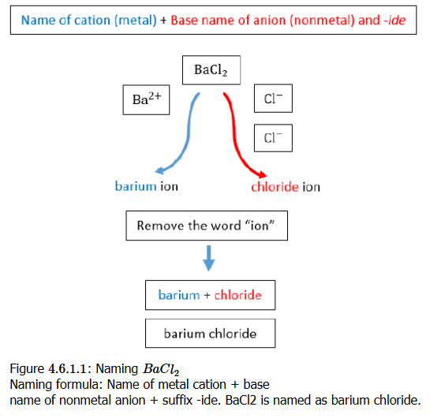
Chemistry Nomenclature: Naming of Compounds

Slide 11
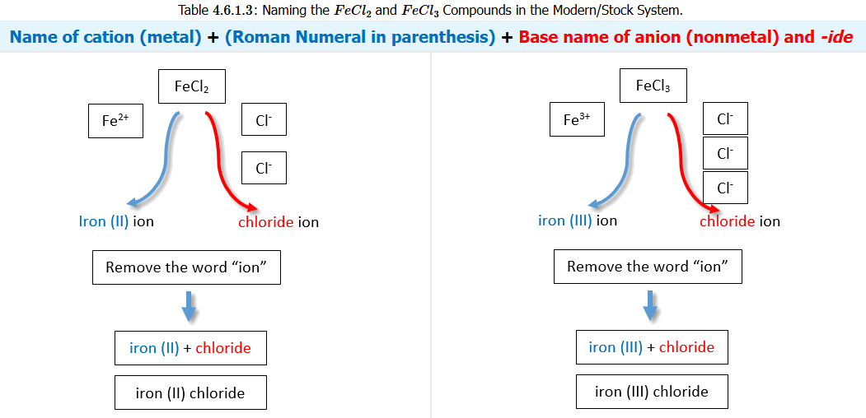
Chemistry Nomenclature: Naming of Compounds

Slide 12
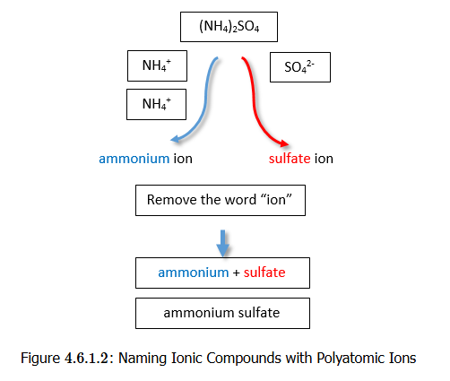
Chemistry Nomenclature: Naming of Compounds

Slide 13
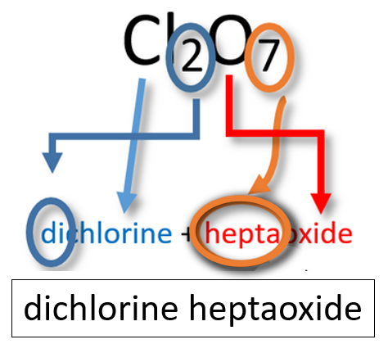
Molecular Compound Naming
Binary Molecular Compounds
Simple (common) molecules

Slide 14
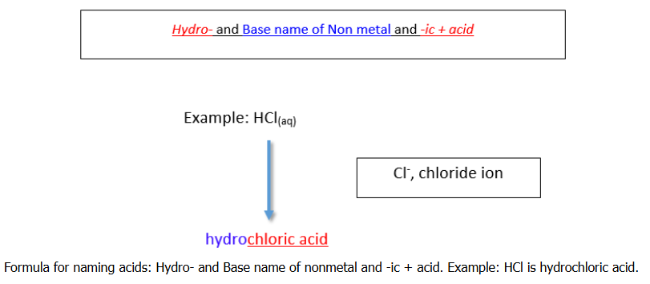
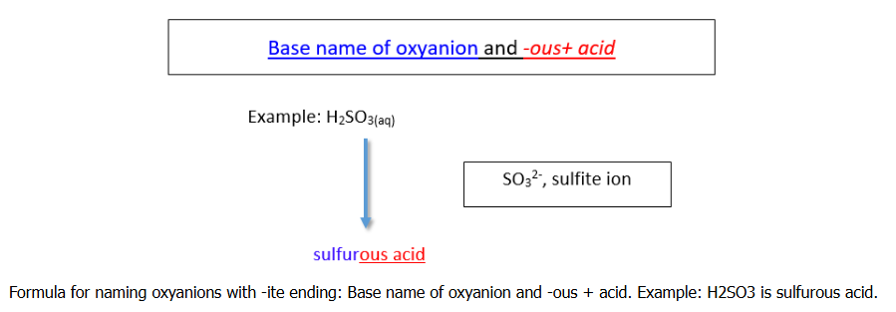
Molecular Compound Naming
Acids
Naming Binary Acids
Naming Oxyacids

Slide 15
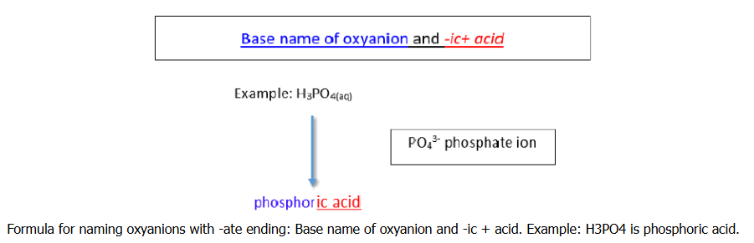
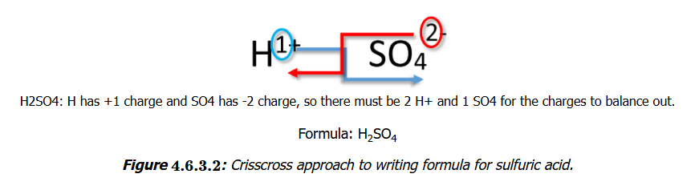
Molecular Compound Naming
Acids
Naming Binary Acids
Naming Oxyacids

Slide 16
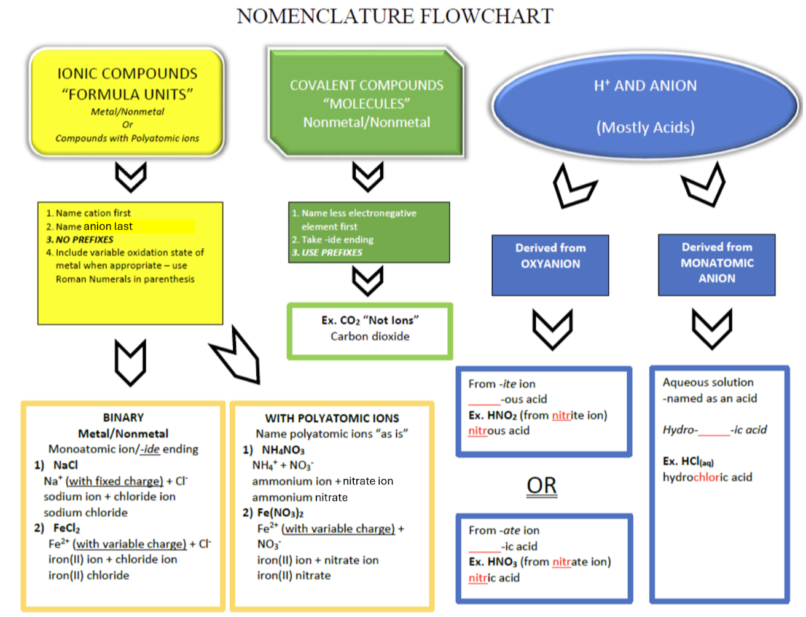
Tying It Together

Slide 17
Introduction to Matter

Slide 18
The Atom
Structure, Components, Properties

Slide 19
The Atom
Atoms are made of three subatomic particles
Protons
which actually give the element its identity
Electrons
chemistry is really about electrons, because it is electrons that allow atoms to bond to each other
Neutrons
it takes about 1800 electrons to equal mass of a proton, and the neutron is slightly bigger than the proton by 0.15%.
Because neutrons have a mass that is slightly higher than sum of a proton & electron, and because neutrons have been shown to decay to a proton, electron, and some other particles in physics, speculation is that a neutron is special gluing of a proton and electron.

Slide 20
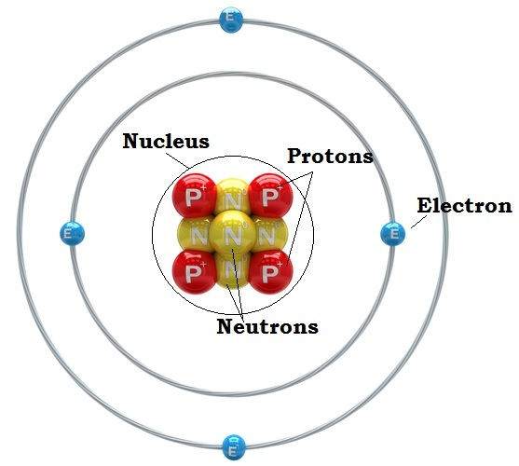
Nucleus & Orbitals
Protons and neutrons organized in the nucleus
Electrons spatially located outside of the nucleus
Electrons "orbit" the nucleus in orbitals but not like planets revolving around the sun
Their position/location is determined by probabilities calculated by complex mathematical expressions
Each orbital pairs two electrons of opposite spin
Yes, electrons have a spin just as the Earth rotates on an axis, and this spin generates a magnetic field

Slide 21

Atomic Weight
Why does hydrogen (H) have an atomic weight of 1.0079?
How is it calculated?

Slide 22
Atomic Weight Explained
Atoms are made of three subatomic particles
Protons
which actually give the element its identity
Electrons
chemistry is really about electrons, because it is electrons that allow atoms to bond to each other
Neutrons
it takes about 1800 electrons to equal mass of a proton, and the neutron is slightly bigger than the proton by 0.15%.
In fact, a neutron may be the combination of the mass of both 1 proton and 1 electron plus the Einstein energy (E = mc²) necessary to slam them together.
Neutrons can undergo radioactive decay into a particle that is +1 (proton or anti-proton) and –1 (electron) particles

Slide 23
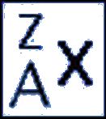
Atomic Weight Explained
Elements all have the same number of protons
But elements can have different number of neutrons
An element with different numbers of neutrons is an isotope of the element
When referring to an isotope of an element, use this
Where
× is element symbol (e.g, hydrogen = H)
A is atomic number, = # protons (A = 1 for H)
Z is mass number, = #protons + #neutrons

Slide 24
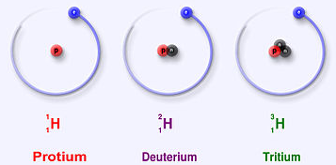
Atomic Weight Explained
Hydrogen has three isotopes:
Protium (¹₁H)
1 proton, 0 neutrons
usually just called "hydrogen"
99.9885% of all hydrogen isotopes in nature is this isotope
Deuterium (²₁H)
1 proton, 1 neutron
It is a stable isotope
0.0115% of hydrogen isotopes is deuterium in nature
Tritium (³₁H)
1 proton, 2 neutrons
It is an unstable isotope, meaning it is radioactive
Probably less than 0.00000001% in nature

Slide 25
Atomic Weight Explained
Atomic weight is calculated by taking the mass of each isotope in atomic mass units and multiplying it by the abundance of each, then summing it all up
Thus
1.007825032 × 0.999885 + 2.0141017778 × 0.000115
= about 1.0079!
Isotope | Mass (amu) | Abundance
¹₁H | 1.007825032 | 0.999885
²₁H | 2.0141017778 | 0.000115

Slide 26
The Periodic Table

Slide 27
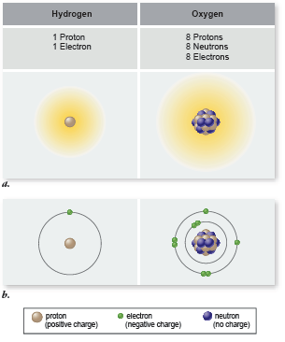
Elements
Elements all have the same number of protons
But elements can have different number of neutrons
An element with different numbers of neutrons is an isotope of the element
When referring to an isotope of an element, use this
Where
× is element symbol (e.g, hydrogen = H)
A is atomic number, = # protons (A = 1 for H)
Z is mass number, = #protons + #neutrons

Slide 28
Hydrogen
Hydrogen has three isotopes:
Protium (¹₁H)
1 proton, 0 neutrons
usually just called "hydrogen"
99.9885% of all hydrogen isotopes in nature is this isotope
Deuterium (²₁H)
1 proton, 1 neutron
It is a stable isotope
0.0115% of hydrogen isotopes is deuterium in nature
Tritium (³₁H)
1 proton, 2 neutrons
It is an unstable isotope, meaning it is radioactive
Probably less than 0.00000001% in natural abundance

Slide 29
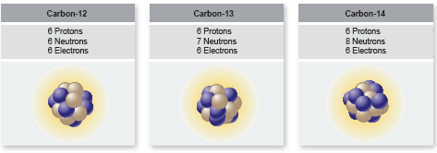
Carbon
Organic chemistry is the chemistry of carbon
Total of 6 electrons in two shells (n =1 and n = 2)
Will use 4 electrons in its valence shell to bond with other atoms
Other atoms it bonds with in biological organisms:
H, N, O, and other C atoms mostly
S, P atoms also

Slide 30
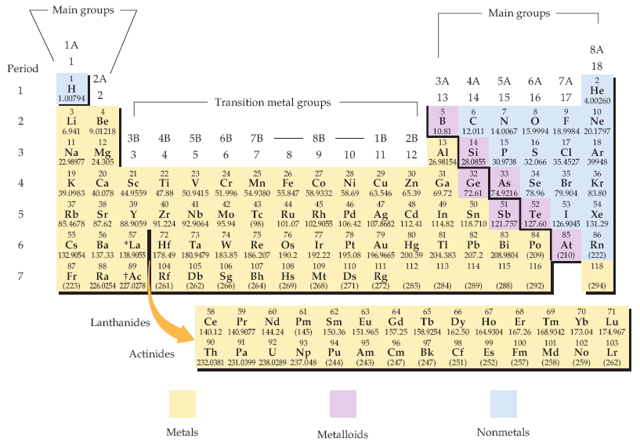
Periodic Table of Elements
Biologists should know what elements are (1) metals and (2) nonmetals generally
The periodic table of the elements. Each element is identified by a one- or two-letter symbol and is characterized by an atomic number. The table begins with hydrogen (H, atomic number 1) in the upper left-hand corner and continues to the yet unnamed element with atomic number 118. The 14 elements following lanthanum (La, atomic number 57) and the 14 elements following actinium (Ac, atomic number 89) are pulled out and shown below the others.
Elements are organized into 18 vertical columns, or groups, and 7 horizontal rows, or periods. The two groups on the left and the six on the right are the main groups; the ten in the middle are the transition metal groups. The 14 elements following lanthanum are the lanthanides, and the 14 elements following actinium are the actinides; together these are known as the inner transition metals. Two systems for numbering the groups are explained in the text. Those elements (except hydrogen) on the left-hand side of the zigzag line running from boron (B) to astatine (At) are metals, those elements to the right of the line are nonmetals, and most elements abutting the line are metalloids.
McMurry et al, Fundamentals of General, Organic and Biological Chemistry, 6 Ed, p 58

Slide 31
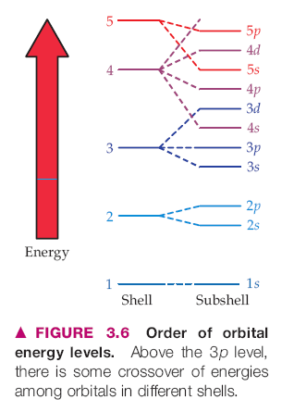
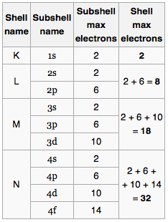
Shells of Electrons & Periodic Table
Each period (row) of the Periodic Table corresponds to a "shell" of electrons
Shells are designated by the principal quantum number n by chemists: n = 1, 2, 3, …
letters K, L, M, N, O, … by physicists
Within the shells are subshells: s, p, d, f
In quantum chemistry/physics, each electron is described by a set of four quantum numbers: {n, l, m_{l}, m_{s}}
There is a correspondence between a shell's energy and its shell number/letter (distance from nucleus): higher shell number relates to higher energy of the electron
The maximum number of electrons in each shell (period) is 2, 8, 8, 18, 18, 32, 32, ..

Slide 32
The Valence Shell
The outermost shell of electrons is where all the chemistry happens
Atoms want to have "complete" shells
This means shedding or giving up electrons if there are too few
Grabbing electrons from other atoms if they need only a few
Giving up electrons means acquiring a positive + charge
Grabbing electrons means acquiring a negative – charge
In forming molecules or crystals, atoms form complete stable shells by having the complete set of electrons in their valence shell, whether or not they share them with other atoms

Slide 33
Electronegativity
The affinity of an atom for one or more electrons
The factors affecting electronegativity are
atom's need to acquire electrons to complete shell
size of atom: smaller atoms more electronegative
atoms are given a value that indicates their electronegativity: the higher the value, the higher the affinity (the more the atom wants electrons)
decreasing order of electronegativity: F, O, Cl, N, Br, I, C, S, Se, H, P
that is, F wants it most, P wants it least in that list
Differences in electronegativity account for type/character of bonding (shown in later slide)

Slide 34
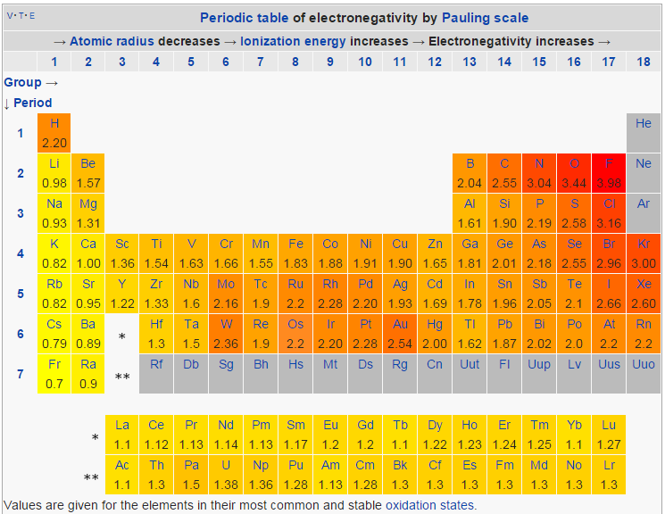
Electronegativity Quantitated
http://en.wikipedia.org/wiki/Electronegativity

Slide 35
Nuclear Chemistry

Slide 36
Chemical Bonding

Slide 37
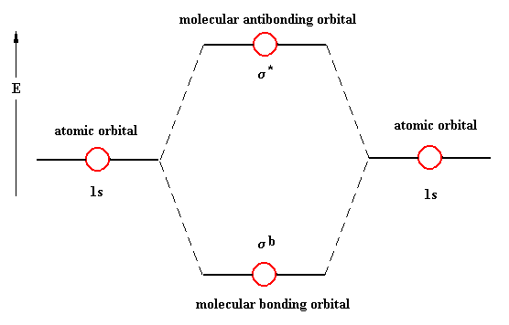
Bonding
Atoms bond using electrons
remember: chemistry is really about the electrons
Electrons in atomic orbitals (AOs) come together between atoms in molecular orbitals (MOs), forming a bonding MO
MOs have two paired (opposite spin) electrons just like AOs
s subshell AOs form σ (sigma)-type MOs (bonds)
p subshell AOs form π (pi)-type MOs (bonds)
there are anti-bonding MOs: they are an excited state type of orbital which, when filled with electrons, actually result in bond-breaking between atoms, not bond-making

Slide 38
Bonding Types & Strength
Type | Description | Strength (kcal/mol)
Ionic / Electrostatic | One atom gives up its electron(s) to another which really wants them: the result is ionized atoms bonding because of electrical attraction (unlike charges) | 50-150
Covalent | Two atoms share the electrons in the bond, neither having a strongly competitive affinity for the electrons (small difference in electronegativity) | 50-100 (single) 100-200 (double) 200-250 (triple)
Hydrogen Bonding | The hydrogen (H) atom is "shared" between two more electronegative atoms | 2-10
Hydrophobic | A "bonding" driven by solvent with polar molecule (H₂O) that prefers to bond to itself (oil & water don't mix) | ND
van der Waals | bonding caused by "induced polarity" from one molecule to another causing a temporary weak electrical attraction | 0.5-1.0

Slide 39
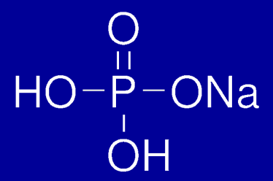
The Covalent Bond
Two atoms that share equally the pair(s) of electrons
Atoms bonding with selves (diatomic molecules) should always be covalent H₂, O₂, N₂, F₂, Cl₂, Br₂, I₂
Can be single, double, and triple bonds between atoms
H₃C—CH₃ (ethane) sigma bond
H₂C=CH₂ (ethene) sigma + pi bond
HC≡CH (ethyne/acetylene) sigma + 2 pi bonds
H—H, O=O, N≡N, F—F, Cl—Cl, Br—Br

Slide 40
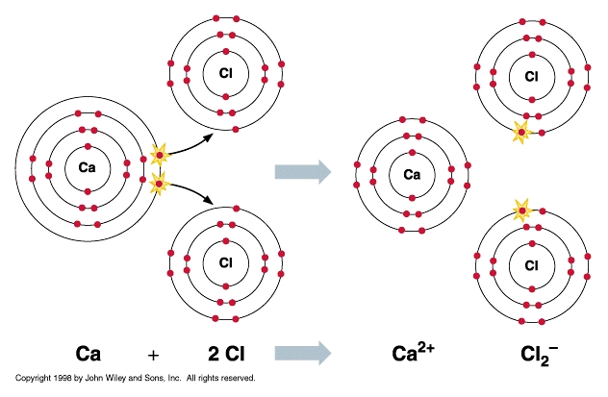
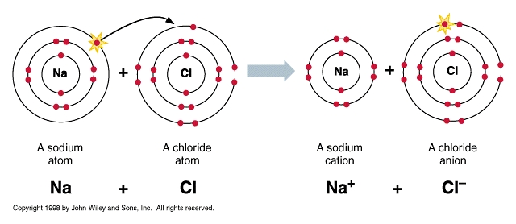
The Ionic / Electrostatic Bond
The bond created by an electrostatic attraction between positive and negative charges resulting from the complete transfer of electrons from one atom to another Na → Na⁺ + e– Cl + e– → Cl– --------------------------------- Na + Cl → Na⁺ + Cl–

Slide 41
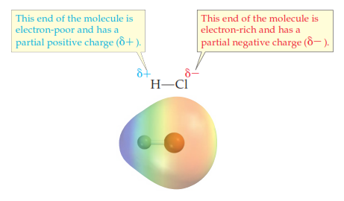
A Polar Covalent Bond
A type of bond that has a mix of covalent and ionic character
The difference in electronegativity of atoms is not such that one atom fully grabs another
Bonds that are polar covalent: O–H, N–H, H–Cl/F (list shown later)
The polar covalent bond accounts for the hydrogen bond

Slide 42
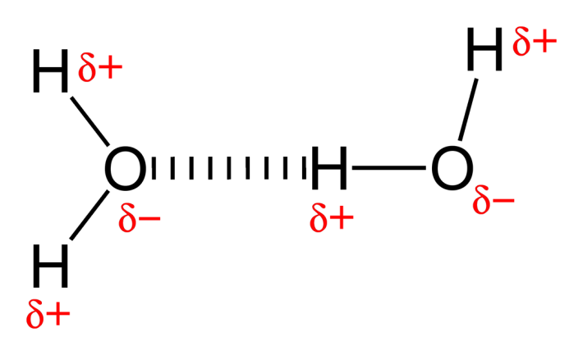
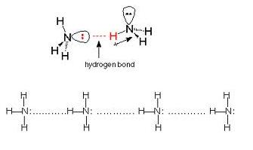
The Hydrogen Bond
The bonding of an H atom already covalently bonded to a more electronegative atom to another more electronegative atom on different molecule
The presence of (a) nonbonding electron pairs in the more electronegative atom is a factor
The presence of N–H and O–H groups in countless biomolecules makes the hydrogen bond significant in all aspects of biochemistry
The double-strandedness of DNA and RNA is because of H-bonding. Polypeptide folding in proteins makes use of H-bonding

Slide 43
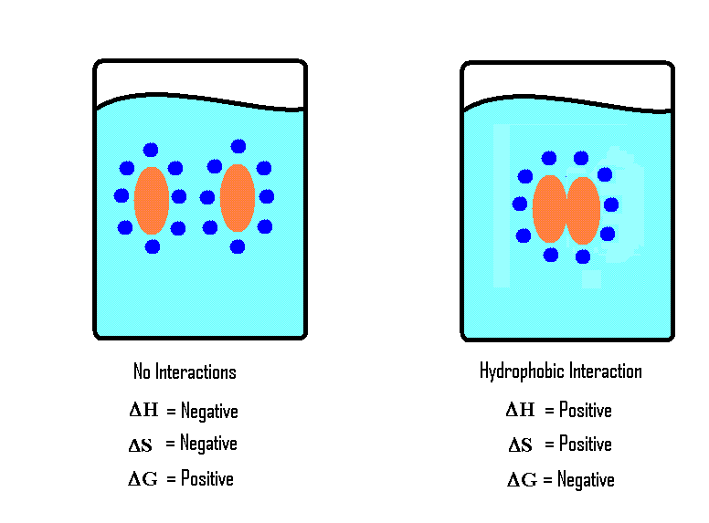
Hydrophobic Interactions
There are no real forces between molecules in hydrophobic molecules associating or clustering together
Instead, the free energy (G) of the solution favors water bonding with itself (by H-bonding) rather than interacting with molecules with which it has no affinity
http://chemwiki.ucdavis.edu/@api/deki/files/8648/image9.GIF

Slide 44
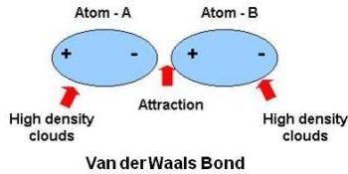
van der Waals Forces
The spatial location of negative charge ("electron cloud") is not perfectly radially distributed about the spherical atom at each moment in time
This transient change in charge symmetry in one atom affects neighboring atoms

Slide 45
Liquids & Solids

Slide 46
Atomic Weight Explained
Atomic weight is calculated by taking the mass of each isotope in atomic mass units and multiplying it by the abundance of each, then summing it all up
Thus
1.007825032 × 0.999885 + 2.0141017778 × 0.000115
= about 1.0079!
Isotope | Mass (amu) | Abundance
¹₁H | 1.007825032 | 0.999885
²₁H | 2.0141017778 | 0.000115

Slide 47
Gases

Slide 48
Atomic Weight Explained
Atomic weight is calculated by taking the mass of each isotope in atomic mass units and multiplying it by the abundance of each, then summing it all up
Thus
1.007825032 × 0.999885 + 2.0141017778 × 0.000115
= about 1.0079!
Isotope | Mass (amu) | Abundance
¹₁H | 1.007825032 | 0.999885
²₁H | 2.0141017778 | 0.000115

Slide 49
Solutions

Slide 50
Atomic Weight Explained
Atomic weight is calculated by taking the mass of each isotope in atomic mass units and multiplying it by the abundance of each, then summing it all up
Thus
1.007825032 × 0.999885 + 2.0141017778 × 0.000115
= about 1.0079!
Isotope | Mass (amu) | Abundance
¹₁H | 1.007825032 | 0.999885
²₁H | 2.0141017778 | 0.000115

Slide 51
Stoichiometry

Slide 52
Substance Quantitation
prefixes: giga 10⁹, mega 10⁶, kilo 10³, deca 10¹, deci 10^{–1}, centi 10^{–2}, milli 10^{–3}, micro 10^{–6}, nano 10^{–9}, pico 10^{–12}, femto 10^{–15}, atto 10^{–18}
Mass
units: grams, kilograms, moles, # molecules
not weight!
Conversions:
When balancing or determining yields from chemical equations, always convert to moles first
Volume
units: cubic ___meters: cm³, mm³, L(iters)
Conversions: 1 mL = 1 cm³, 1 L = 1000 ml

Slide 53
Substance Quantitation
Concentration
units: G/L, mol/L, M, %(w/v), %(v/v), ppm, etc, etc
mass of a solute in the volume of a solution
solution = solute + solvent
note density = mass/volume, but of a pure substance!
mass of solute = concentration × volume
stock solutions / reagents
[ g ←AW/MW→ mole ] weighed out: add solvent to final volume
dilutions: C_{concentrated} ×V_{concentrated} = C_{dilution} × V_{dilution}

Slide 54
Empirical Formula
The empirical formula of any compound / molecule will be
A_{x}B_{y}C_{z}
where A, B, and C are the component atoms of the compound and the ×, y, and z subscripts represent the relative molar content of each of the component atoms
The ×, y, z subscript values do not necessarily the actual atom numbers in a compound. The empirical formula for the carbohydrate glucose is:
CH₂O
But the actual molecular formula—which is NOT the same as the empirical formula—is
C₆H₁₂O₆
The molecular formula is thus a multiple of the empirical formula
Note if a subscript value = 1, it is omitted

Slide 55
Empirical Formula from Percent Composition
You will need the atomic weights (from the periodic table) of all component atoms
Assume you have 100 grams of the compound/molecule: calculate the number of grams of each component atom from the percent of the component atom
From each component atom mass in grams, compute the number of moles of each component atom
Compute the relative mole ratios of all component atoms to the one component atom with the lowest mole value
That is, divide the mole values of all component atoms by the atom with the lowest mole value

Slide 56
Empirical Formula from Percent Composition
Worked Example #1
Percent composition of copper chloride is 64.1% Cu and 35.9% Cl. What is empirical formula?
That is we want to know × and y of Cu_{x}Cl_{y}
atomic weights: Cu = 63.546 g/mol, Cl = 35.453 g/mol
Component atom masses in grams of 100 grams of copper chloride:
(0.641)(100 g) = 64.1 g Cu (0.359)(100 g) = 35.9 g Cl
iii) # moles of each component atom: (64.1 g Cu)(1 mole/63.546 g Cu) = 1.01 ~ 1
(35.9 g Cl)(1 mole/35.453 g Cl) = 1.01 ~ 1
iv) dividing by lowest mole value since both are equal to 1, they are both equal in mole content. So empirical formula is CuCl

Slide 57
Empirical Formula from Percent Composition
Worked Example #2
Trichloroethylene (TCE) is 18.25% carbon, 0.77% hydrogen, and 80.99% chlorine by weight. What is empirical formula?
That is we want to know TCE with C_{x}H_{y}Cl_{z}
atomic weights: C = 12.011 g/mol, H = 1.008 g/mol, Cl = 35.453 g/mol
Component atom masses in grams of 100 grams of TCE:
C: (0.1825)(100 g) = 18.25 g C H: (0.0077)(100 g) = 0.77 g H
Cl: (0.8099)(100 g) = 80.99 g Cl
iii) # moles of each component atom: C: (18.25 g C)(1 mole C/12.011 g C) = 1.52
H: (0.77 g H)(1 mole H/1.008 g H) = 0.764
Cl: (80.99 g Cl)(1 mole Cl/35.453 g Cl) = 2.28
iv) dividing by lowest mole value C: 1.52 / 0.764 = 1.99 ~ 2, H: 0.764 / 0.764 = 1,
Cl: 2.28 / 0.764 = 2.98 ~ 3
Empirical formula: C₂HCl₃

Slide 58
Balancing Reactions
These rules come first in the balancing of all chemical reactions ("equations")
Mass is always conserved
Charge is always conserved
Additional rule
Compounds / molecules must actually exist

Slide 59
Balancing Reactions: Mass Conservation
If there are N atoms of element × on the left side of the arrow (reactants), there must be N atoms of element × on the right side of the arrow (products)
Pay attention to coefficients and subscripts!!
2 H₂O → 2 H₂ + O₂
There are 4 atoms of H & 2 atoms of O on both sides of the arrow
2 Na + 2 H₂O → 2 NaOH + H₂
There are 2 atoms of Na, 4 atoms of H, and 2 atoms of O on both sides of the arrow
2 + 2 H₂O → 2 NaOH + H₂

Slide 60
Balancing Reactions: Charge Conservation
These rules come first in the balancing of all chemical reactions ("equations")
Mass is always conserved
If there are N atoms of element × on the left side of the arrow (reactants), there must be N atoms of element × on the right side of the arrow (products)
Pay attention to coefficients and subscripts!!
2 H₂O → 2 H₂ + O₂
There are 4 atoms of H & 2 atoms of O on both sides of the arrow
Charge is always conserved

Slide 61
Balancing Reactions: Half Reactions
These rules come first in the balancing of all chemical reactions ("equations")
Mass is always conserved
If there are N atoms of element × on the left side of the arrow (reactants), there must be N atoms of element × on the right side of the arrow (products)
Pay attention to coefficients and subscripts!!
2 H₂O → 2 H₂ + O₂
There are 4 atoms of H & 2 atoms of O on both sides of the arrow
Charge is always conserved

Slide 62
Chemical Reactions

Slide 63
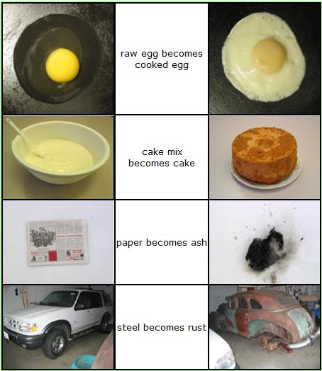
Chemical Reactions
Bond breaking and formation
Movements of electron (singly or as pairs) from one atom or molecule to another
Atoms or molecules acquiring electrical charges positive or negative (or losing them: uncharged)
Common, daily chemical reactions
https://wikis.engrade.com/science1012011/chemicalreactions

Slide 64
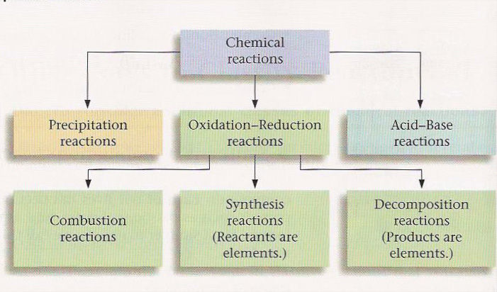
Types of Chemical Reactions
6 Types of Reactions
Combustion C₁₀H₈ + 12 O₂ → 10 CO₂ + 4 H₂O
Synthesis 8 Fe + S₈ → 8 FeS
Decomposition 2 H₂O → 2 H₂ + O₂
Single Displacement Mg + 2 H₂O → Mg(OH)₂ + H₂
Double Displacement Pb(NO₃)₂ + 2 KI → PbI₂ + 2 KNO₃
Acid-Base HBr + NaOH → NaBr + H₂O
http://quinton.pbwiki.com/f/textbookfig712edit.jpg

Slide 65
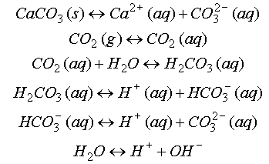
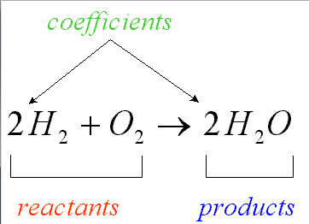
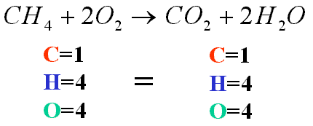
Balancing Mass & Charge
Laws of conservation of mass and electrical charge require that chemical (reaction) equations be balanced for mass and charge
http://ion.chem.usu.edu/~sbialkow/Classes/3600/Overheads/Carbonate/image020.gif
http://www.mikeblaber.org/oldwine/chm1045/notes/Stoich/Equation/balance4.gif

Slide 66
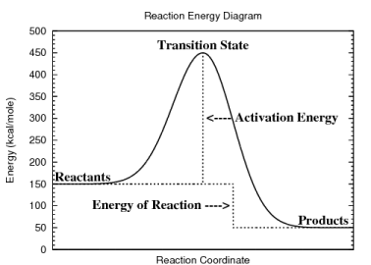
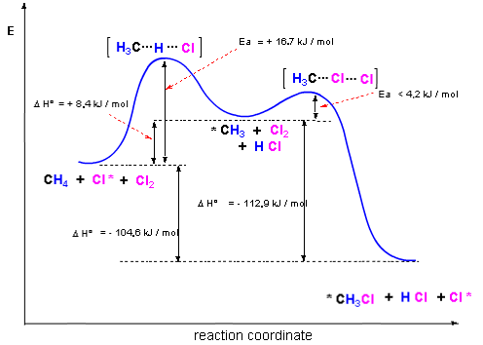
Reaction Energy Diagrams
Diagrams show changes in the (potential) energy along a "reaction coordinate"
A reaction coordinate is basically a state of the reaction: reactants, activated complexes or transition states, products
Often show detail of energy values
http://www.personal.kent.edu/~cearley/gen50/review/rxnEnergy.png

Slide 67
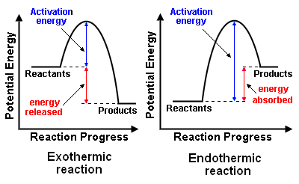
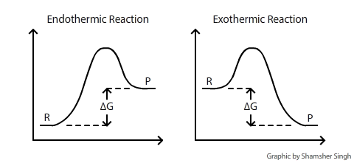
Endothermic & Exothermic
Exothermic Reactions reactions releasing energy: work done, heat released
gasoline combustion
Endothermic Reactions reactions requiring energy: put them on the hot plate
dissolving urea in water
http://chemwiki.ucdavis.edu/@api/deki/files/120/delta_g_diagram.png
http://en.citizendium.org/images/f/fb/ExoEndo_Reax.png

Slide 68
Equilibrium
A lot of math problems can be more easily understood by CAREFULLY reading each word in a described problem and by knowing the definitions
If you know these, just consider it a good review

Slide 69
Atomic Weight Explained
Atomic weight is calculated by taking the mass of each isotope in atomic mass units and multiplying it by the abundance of each, then summing it all up
Thus
1.007825032 × 0.999885 + 2.0141017778 × 0.000115
= about 1.0079!
Isotope | Mass (amu) | Abundance
¹₁H | 1.007825032 | 0.999885
²₁H | 2.0141017778 | 0.000115

Slide 70
Kinetics
A lot of math problems can be more easily understood by CAREFULLY reading each word in a described problem and by knowing the definitions
If you know these, just consider it a good review

Slide 71
Atomic Weight Explained
Atomic weight is calculated by taking the mass of each isotope in atomic mass units and multiplying it by the abundance of each, then summing it all up
Thus
1.007825032 × 0.999885 + 2.0141017778 × 0.000115
= about 1.0079!
Isotope | Mass (amu) | Abundance
¹₁H | 1.007825032 | 0.999885
²₁H | 2.0141017778 | 0.000115

Slide 72
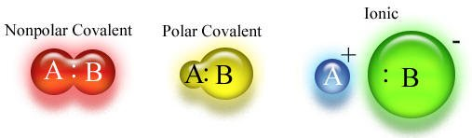
Spectrum of Sharing
Covalent ←→ Polar Covalent ←→ Ionic bonding is a spectrum of atomic affinity for electrons
The spectrum is evidenced by the differences of the electronegativity of atoms
(Nonpolar) Covalent
N—O, diatomic forms (H₂, O₂, N₂), C—H, C—S
Polar Covalent
O—H, N—H, O—C, N—C, O—P
Ionic
Metal + nonmetal: Na+ –Cl, K+ –Cl, Na+ –OH,

Slide 73
Electronegativity Values
H: 2.20 , C: 2.55 , O: 3.44, N: 3.04, P: 2.19 S:2.58
Criteria: Electronegativity Difference (Δ)
Δ < 0.4: covalent
0.4 < Δ < 2: polar covalent
Δ > 2: ionic
Common Bonded Atoms in Biology
O—H 3.44 – 2.20 = 1.24 polar covalent
C—H 2.55 – 2.20 = 0.35 covalent
C—O 3.44 – 2.55 = 0.99 polar covalent
C—N 3.04 – 2.55 = 0.49 polar covalent
N—H 3.04 – 2.20 = 0.84 polar covalent
P—O 3.44 – 2.19 = 1.25 polar covalent
C—S 2.58 – 2.55 = 0.03 covalent
S—O 3.44 – 2.58 = 0.86 polar covalent

Slide 74
Ions
electrically charged atoms and molecules
ionized atoms: Na⁺, Cl–, K⁺, Ca²⁺, Mg²⁺
ionized molecules
H₃O⁺, HPO₄^{2–}, NH₄⁺ C₄H₄O₄^{2–} (succinate: molecular formula) –OOC-CH₂-CH₂-COO– (succinate: structural formula)
cations: positively charged ions
move toward cathode (– pole)
anions: negatively charged ions
move toward anode (+ pole)

Slide 75
The Molecule
Atoms that are covalently bonded to each other
Ionic compounds (and their solid forms crystals) (e.g. NaCl, table salt) are not molecules because the bonding is not covalent
A group of bonded atoms that are all non-metal atoms is a molecule

Slide 76
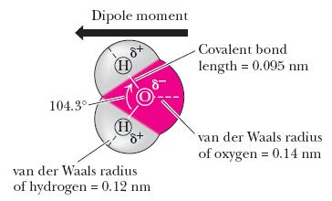
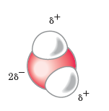
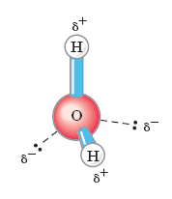
H₂O – Structure
O atom more electronegative
greater affinity for electrons
both bonding and nonbonding electrons (electron pairs)
O-H bond covalent ("shared" bonding electrons) but polar
Garrett & Grisham, Biochemistry (5ed, 2013)
Lehniinger, Biochemistry (4ed, 2005)

Slide 77
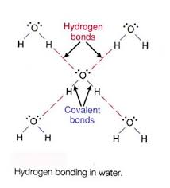
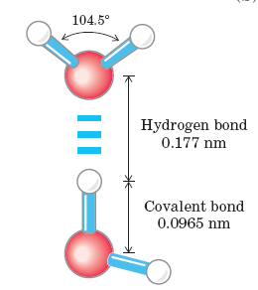
Water – Hydrogen Bonding
H-bonding: the H atom covalently bonded to an O atom in one H₂O molecule forms a weak bond with one of the two unbonded pairs in the valence shell of the O atom of another H₂O molecule
A "weak" bond is a relatively lower energy bond than the covalent bond, but still significant
Water (liq H₂O) forms at temperatures < 100°C with H bonds
These are broken when water boils

Slide 78
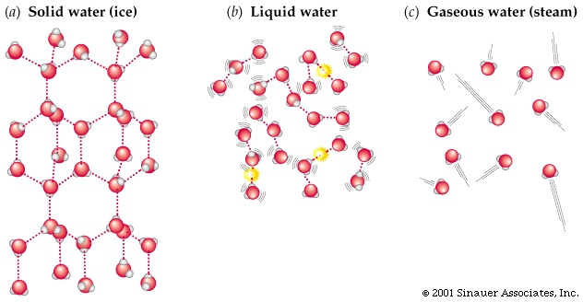
H₂O Phases
ice: H-bonded in a less dense space
water: H-bonds formed & unformed rapidly in more dense space
vapor: no H-bonding as they gallivant through space
animation shows H₂O as water solvating a chloride ion. Note yellow flashes are H-bonds forming & unforming

Slide 79
Water – Properties
High specific heat 1 cal/g/°C
This enables water to resist changes in temperature when heat energy enters or exits
Polar
A great many organic and inorganic solutes dissolve in it, providing the environment for biochemical reactions
Cohesive because of the H-bond
Water's surface tension resists loss of solvent as well as accounts for capillary flow exploited by organisms
Organisms composed of 70-90% water

